Slide 1
Enhancing Teacher Communication with Supra-Sequences
A Paradigm Shift in Educational Collaboration

Slide 2
Presentation roadmap
Introduction
PER
The concept of supra-sequences
Use case
Proposed tool
Demonstration
Survey results
Conclusions

Slide 3
Introduction
How can the integration of a cross-disciplinary planning tool in the educational system influence teacher engagement and student learning outcomes?

Slide 4
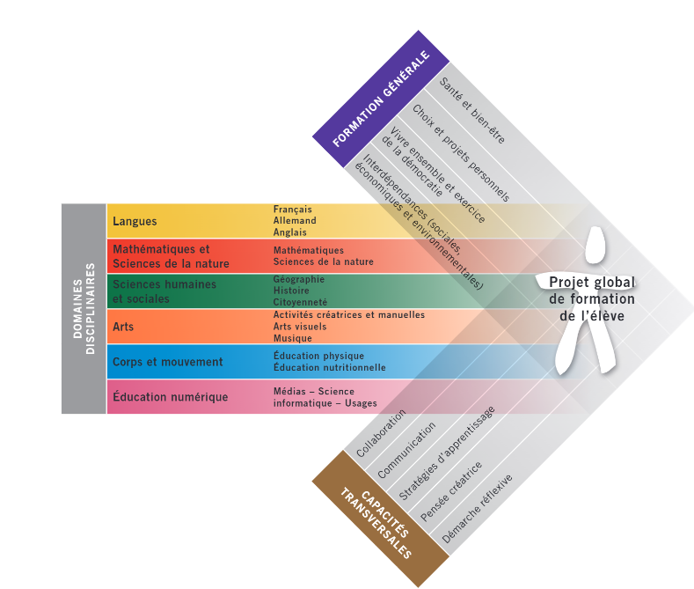
PER (Plan d’étude Roman)
Comprehensive plan for education
Agreed upon by all French speaking Cantons
Students from 4 to 15 years old
Standardization of learning

Slide 5
Supra-sequence
Focus on a PER objective from General or Cross Education
Span multiple weeks, across any Subject
Initiated by teacher for one class
Can be joined by teacher on a voluntary basis
Each teacher can, in the context of the Supra-sequence :
See what's been done by other teachers
Plan for what will be done in the supra-sequence
Allows to adapt the future lessons

Slide 6
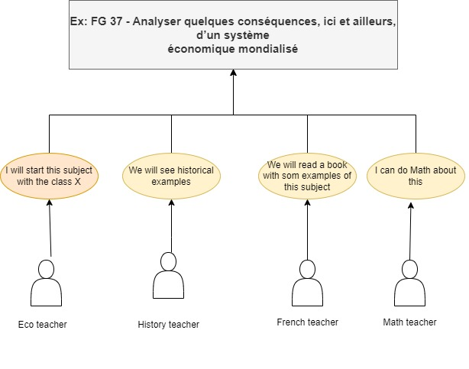
Use case

Slide 7
Proposed tool
Web application
Ease of access
Disponibility
App with login
Each teacher has it’s own profil
Ability to follow his classes
Ease of use

Slide 8
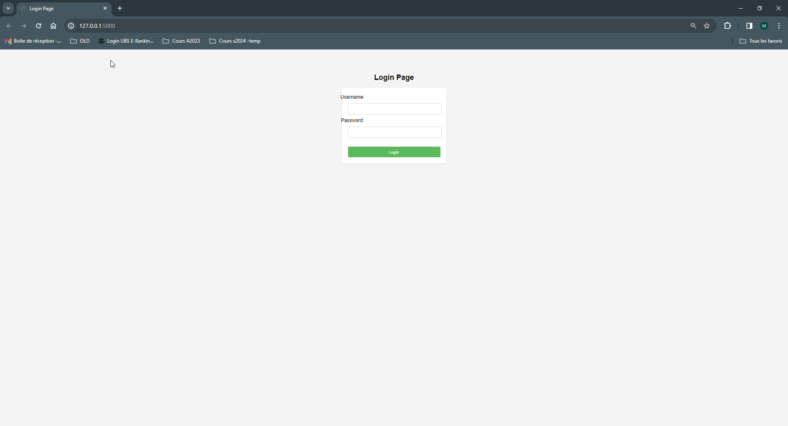
Demo

Slide 9
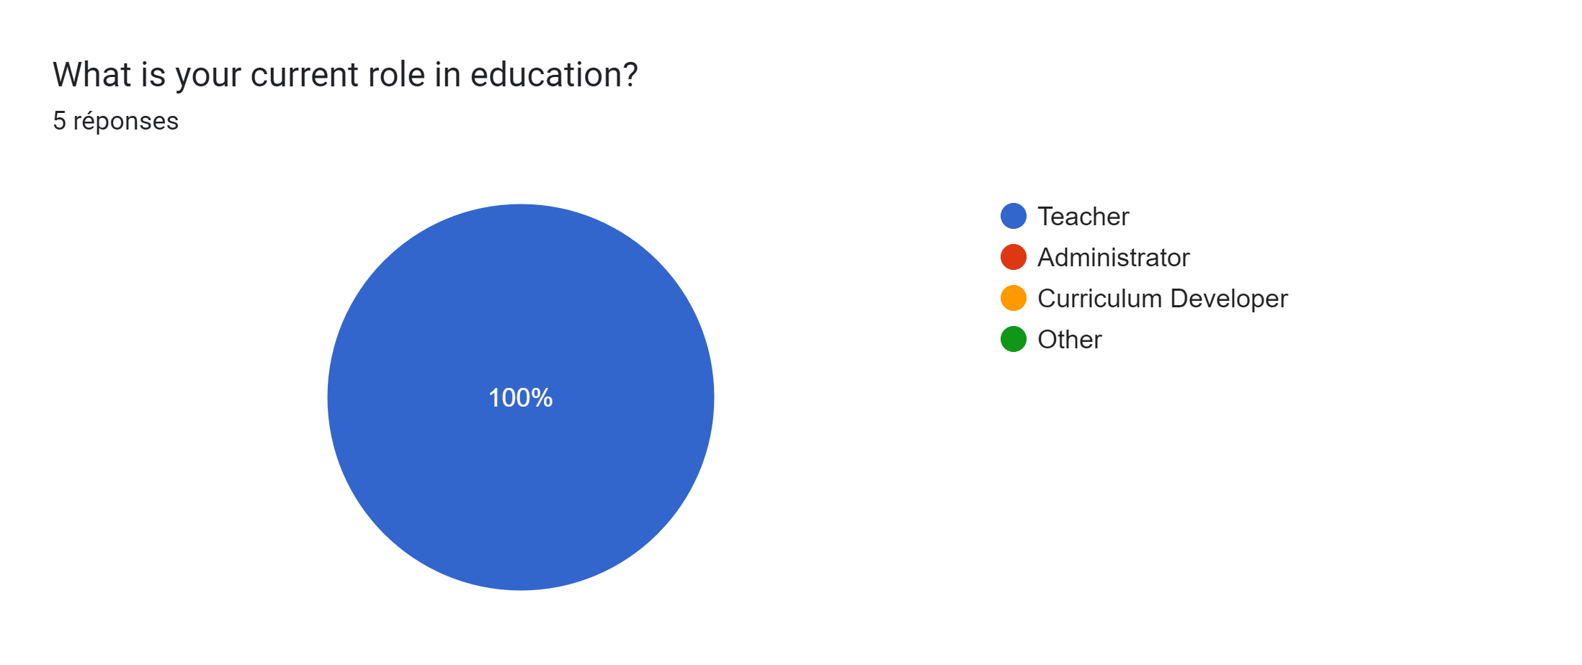
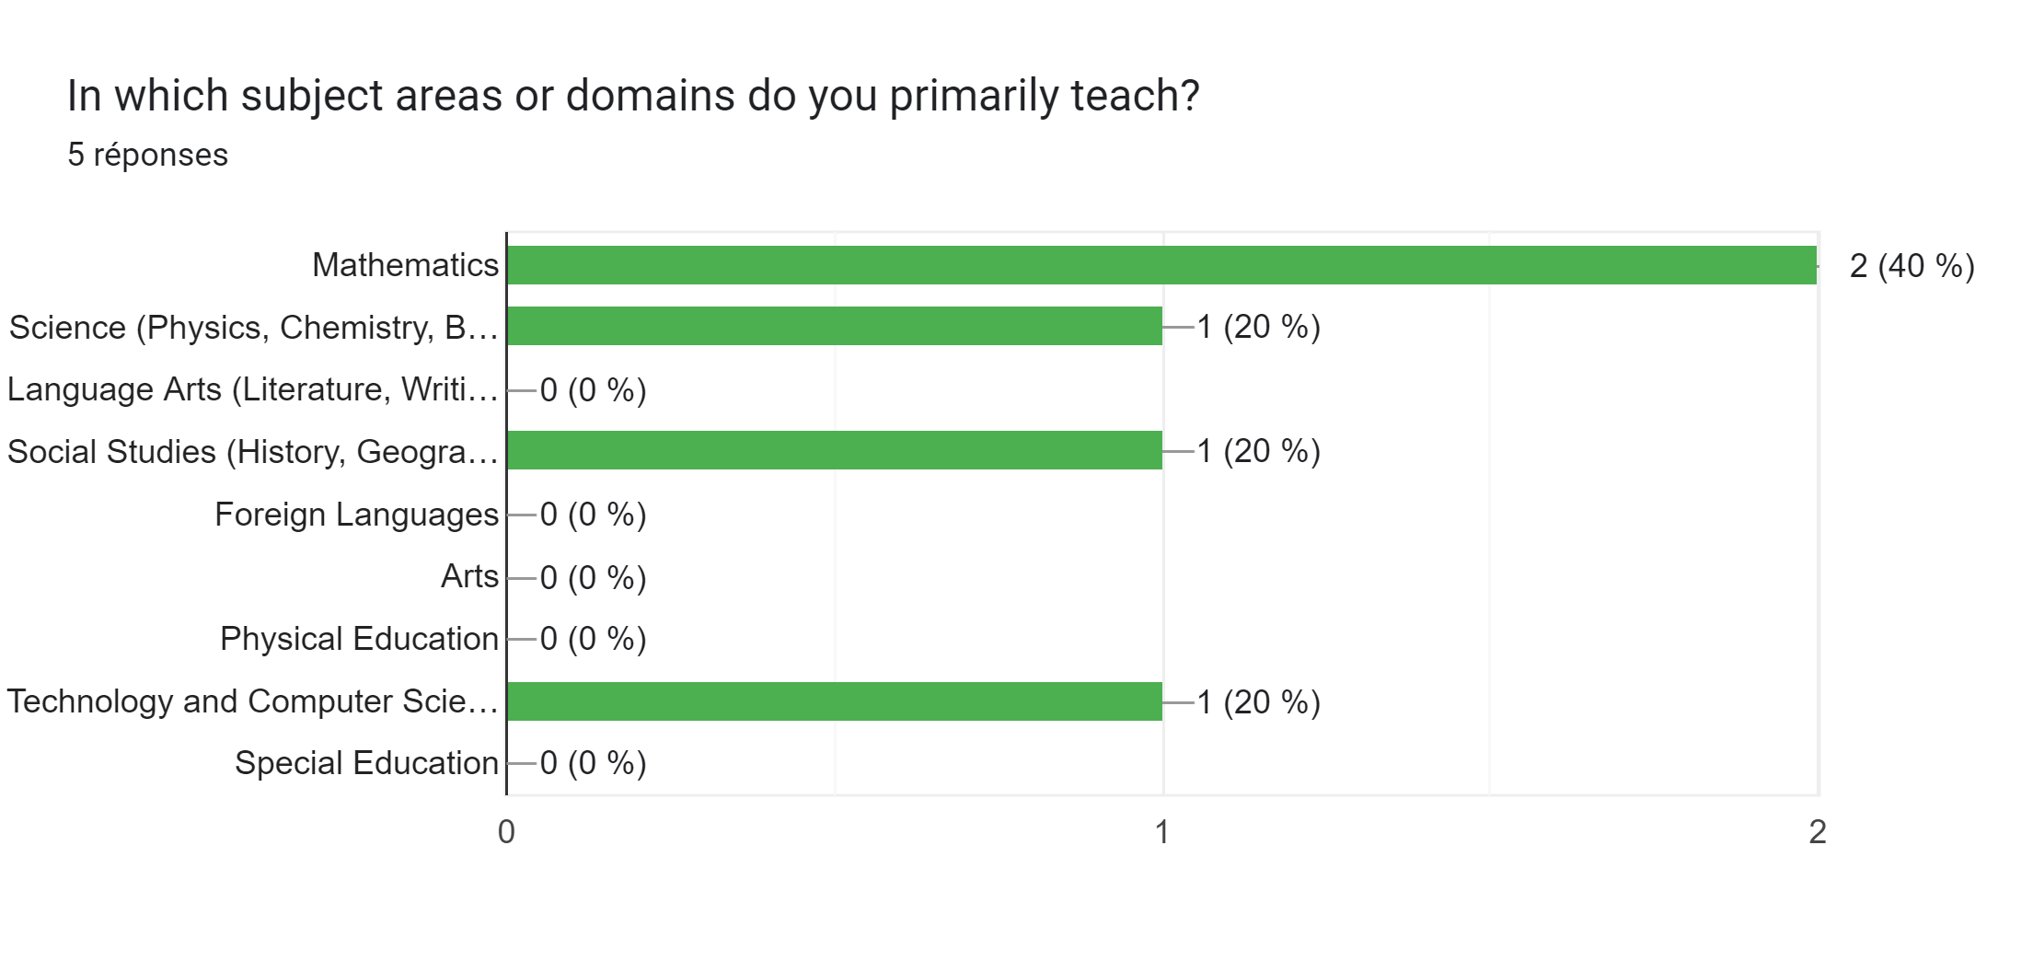
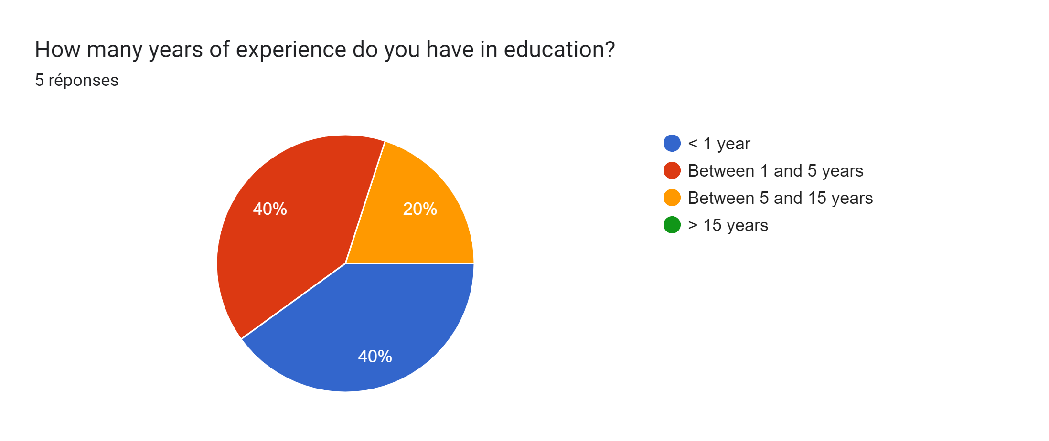
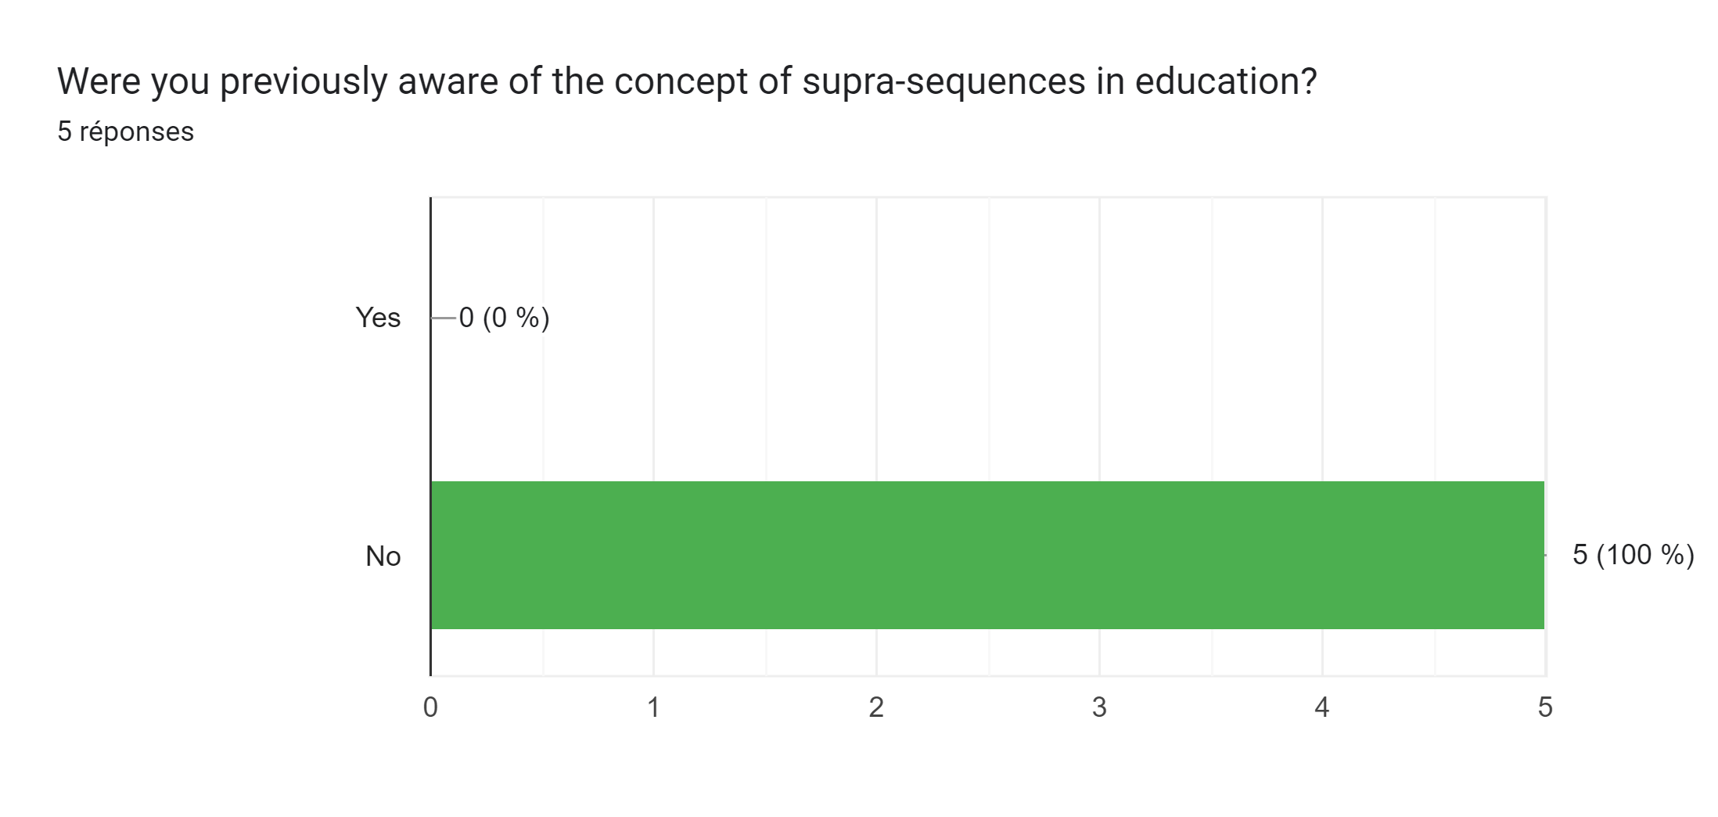
Survey

Slide 10
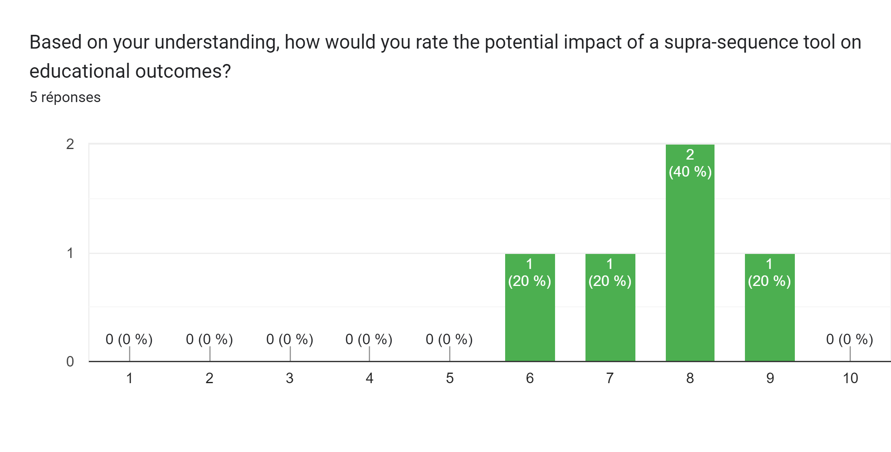
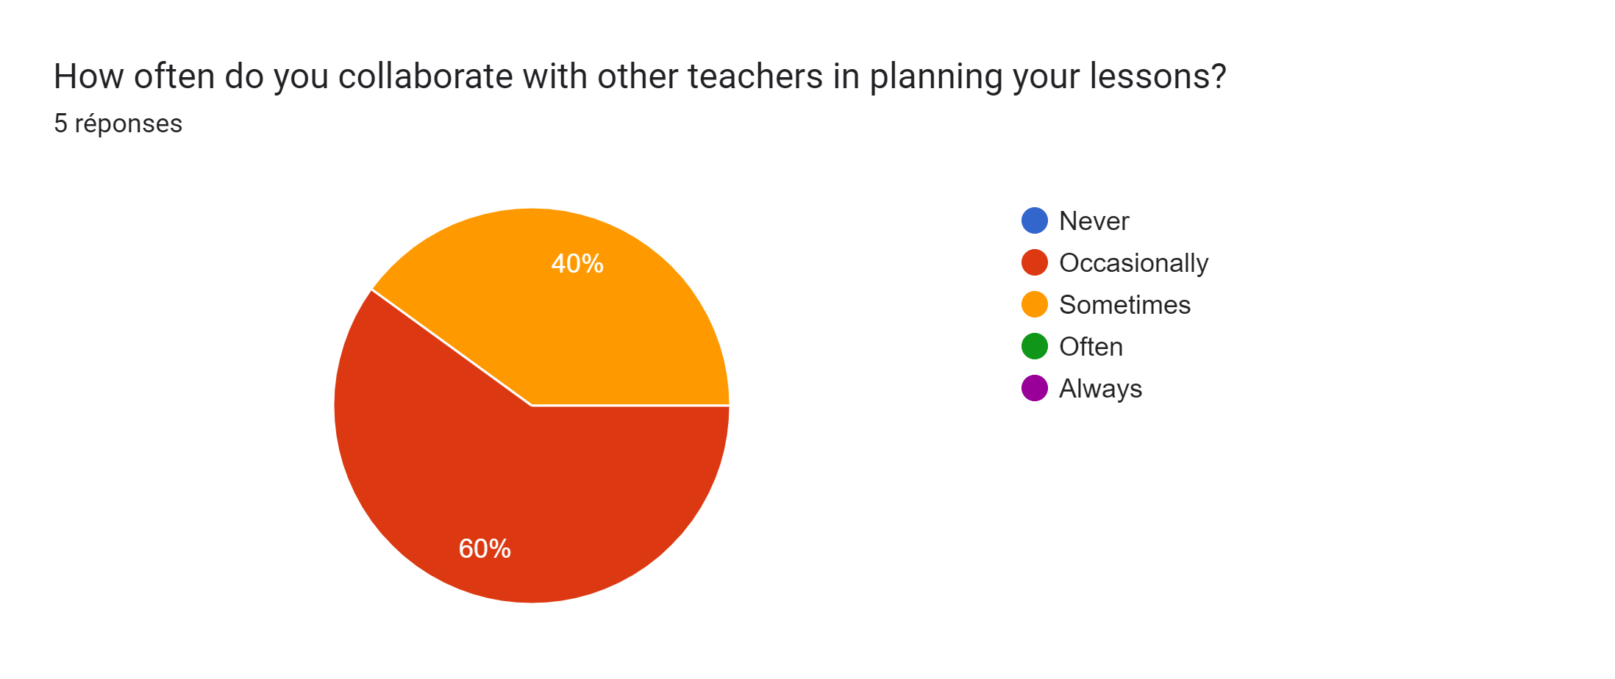
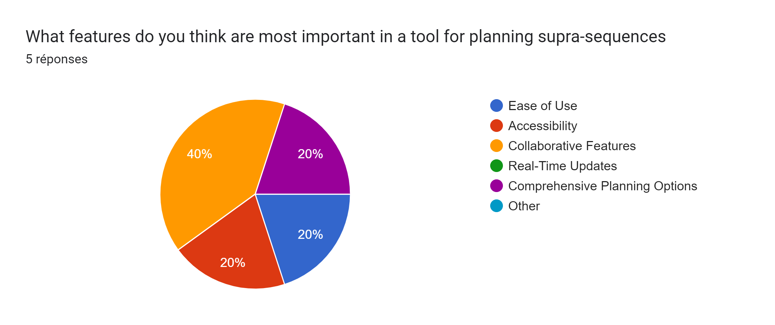
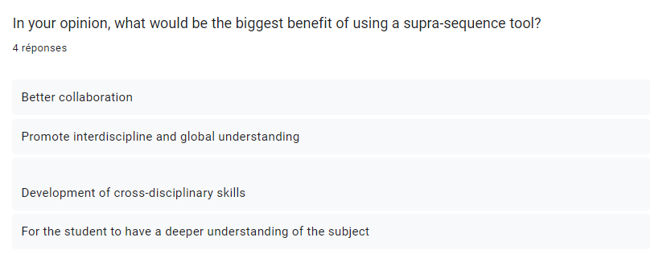
Survey

Slide 11
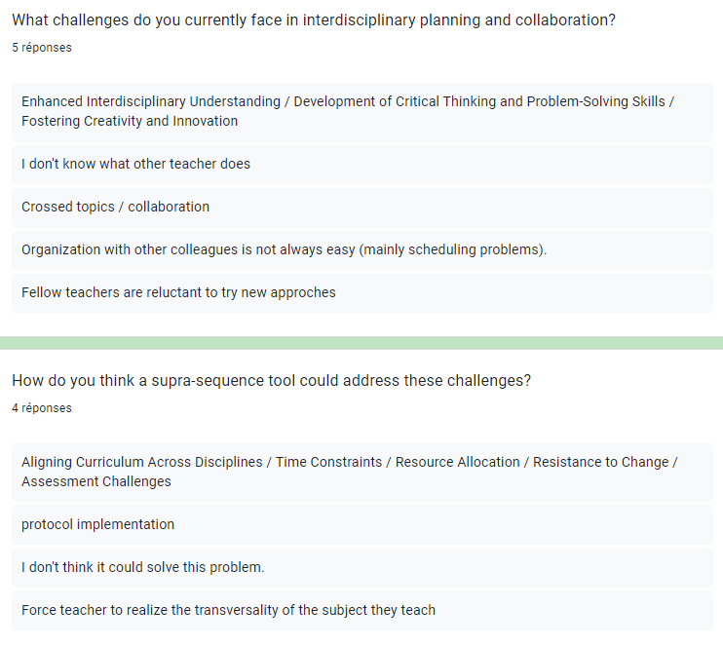
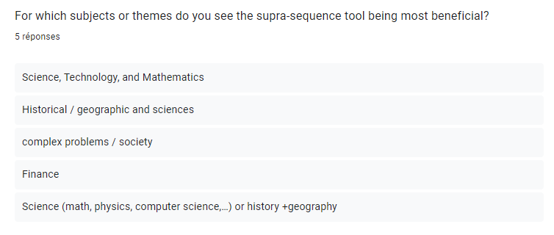
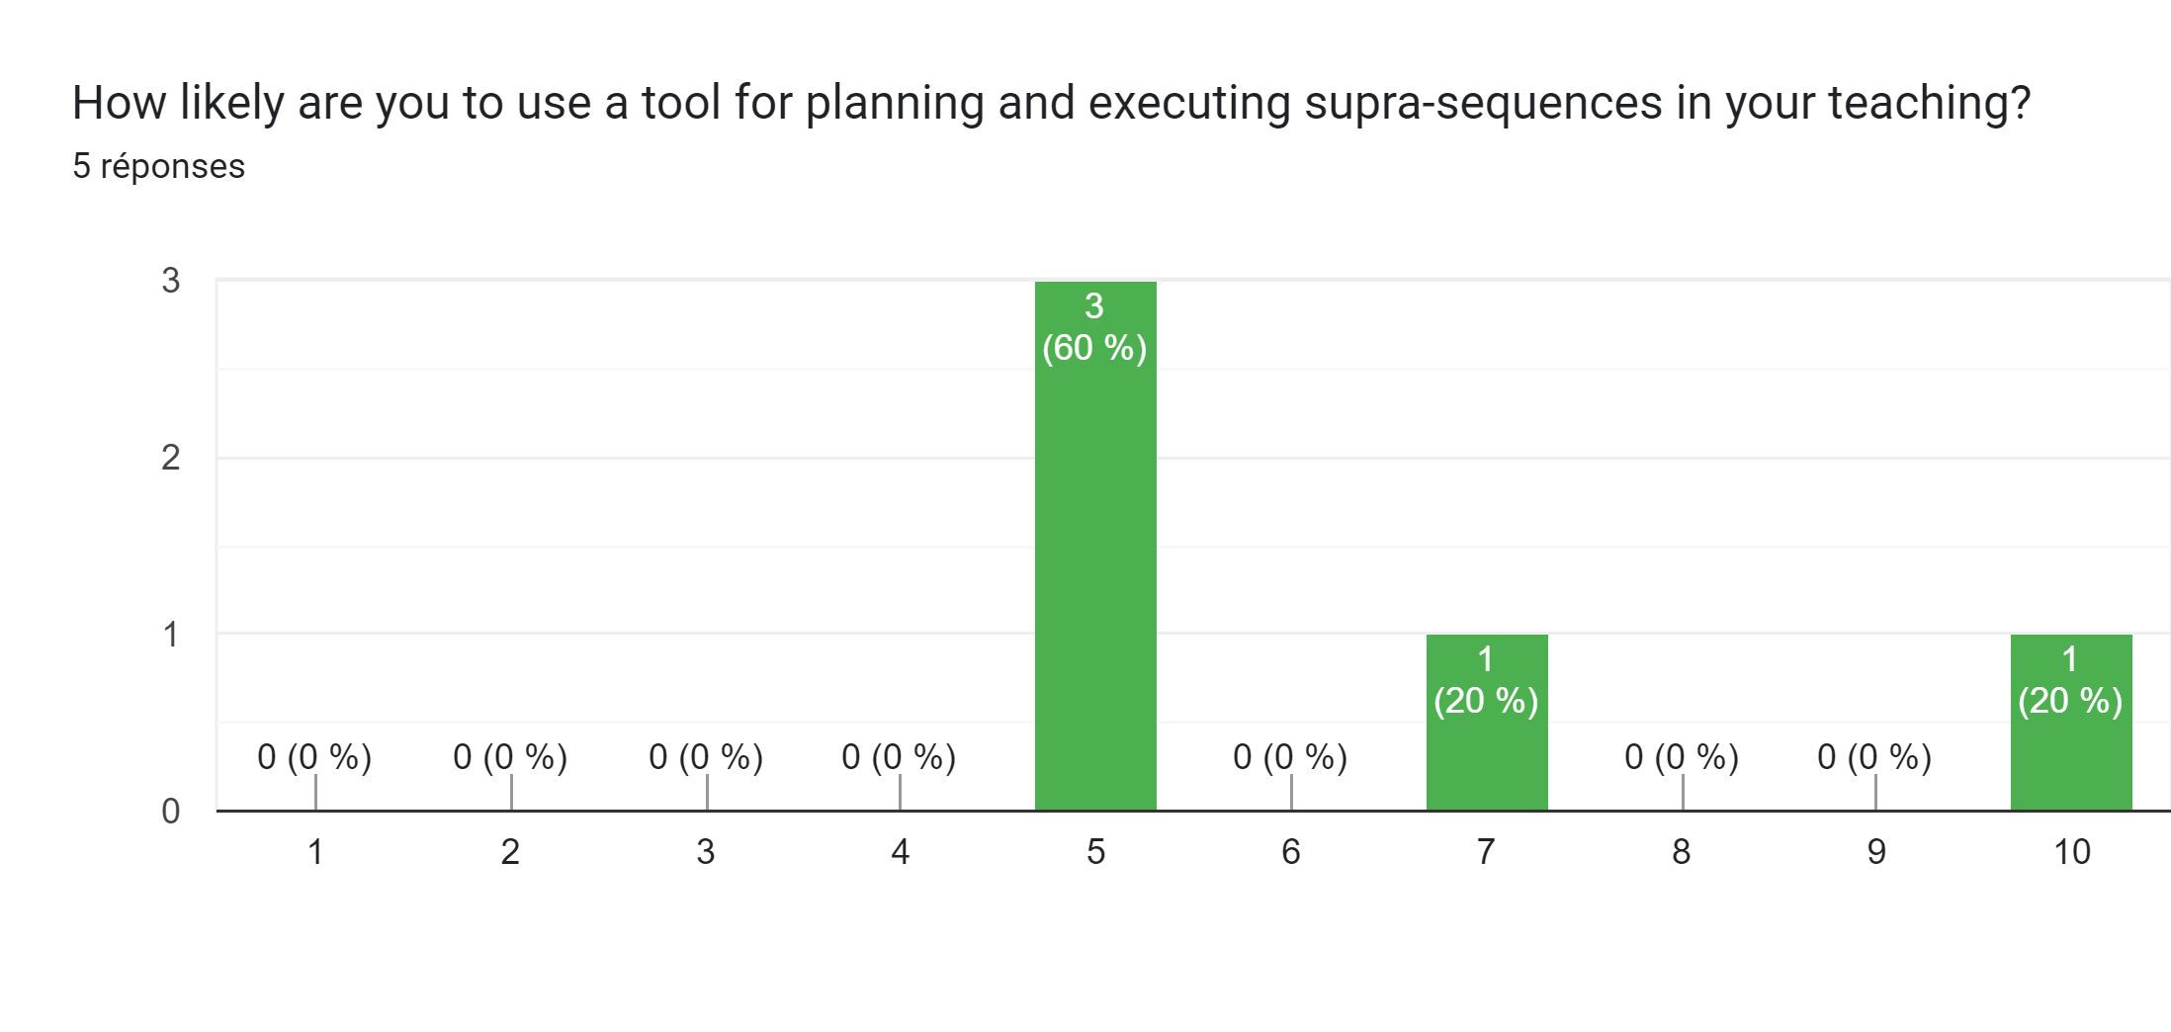
Survey

